Slide 1
Chapter 2 Configuration Space
Chapter 3 Rigid-Body Motions
Chapter 4 Forward Kinematics
Chapter 5 Velocity Kinematics and Statics
Chapter 6 Inverse Kinematics
Chapter 7 Kinematics of Closed Chains
Chapter 8 Dynamics of Open Chains
Chapter 9 Trajectory Generation
Chapter 10 Motion Planning
Chapter 11 Robot Control
11.1 Control System Overview
11.2 Error Dynamics
11.3 Motion Control with Velocity Inputs
Chapter 12 Grasping and Manipulation
Chapter 13 Wheeled Mobile Robots

Slide 2
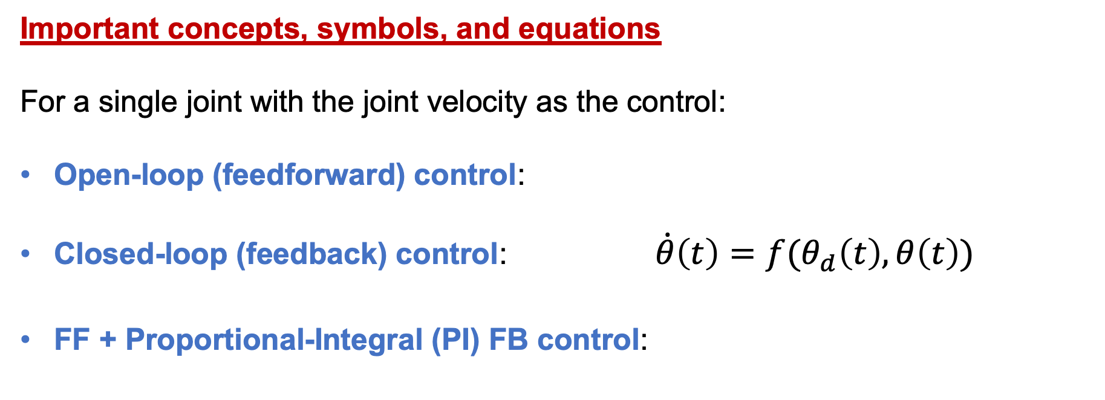
Important concepts, symbols, and equations
For a single joint with the joint velocity as the control:
Open-loop (feedforward) control:
Closed-loop (feedback) control: $\dot{θ}\left(t\right)=f(θ_{d}\left(t\right),θ\left(t\right))$
FF + Proportional-Integral (PI) FB control:
, K_{p}, K_{i} ≥ 0
What is the point
of FF control in
this control law?
• reduces to FF control if K_{p}, K_{i} = 0
• if no FF term: P control when K_{i} = 0, I control when K_{p} = 0

Slide 3
Important concepts, symbols, and equations (cont.)
Block diagram

Slide 4

Important concepts, symbols, and equations (cont.)
Setpoint control, $θ_{d}\left(t\right)=c$, with a P controller

Slide 5
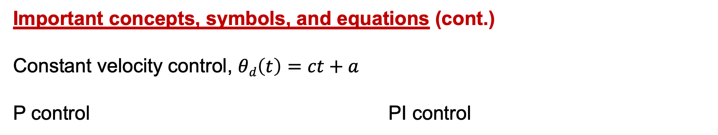
Important concepts, symbols, and equations (cont.)
Constant velocity control, $θd\left(t\right)=ct+a$
P control PI control

Slide 6
Important concepts, symbols, and equations (cont.)
characteristic equation of PI error dynamics:
What if K_{i} = 0?
root locus
as K_{i} increases

Slide 7
Important concepts, symbols, and equations (cont.)

Slide 8
Important concepts, symbols, and equations (cont.)
Multi-joint control: 𝜃, 𝜃_{d}, and 𝜃_{e} are vectors and K_{p} = k_{p} I, K_{i} = k_{i} I

Slide 9
Important concepts, symbols, and equations (cont.)
Task-space motion control
desired
motion
actual
motion
error:

Slide 10
Important concepts, symbols, and equations (cont.)
Decoupled task-space motion control
What is this Jacobian?

Slide 11
Important concepts, symbols, and equations (cont.)
X(0)
X(0)
X_{d}
X_{d}
task-space P controller
decoupled task-space P controller

Slide 12
You are designing a P controller to track a joint reference trajectory that is
moving at a constant rate of 3 radians/s. What is the smallest gain K_{p} that
ensures a steady-state position error of no more than 0.1 radians? Give units.
To eliminate steady-state error, you decide to use a PI controller. What gains
K_{p} and K_{i} should you choose to achieve critical damping and a settling time of
0.1 s? Give units.
Explain how to estimate the error integral if the controller’s frequency is 1/T.
Why not choose arbitrarily large K_{p} and K_{i} to achieve arbitrarily fast settling?
How well would a PI controller track a quadratic joint trajectory? (Not a ramp.)

